Slide 1
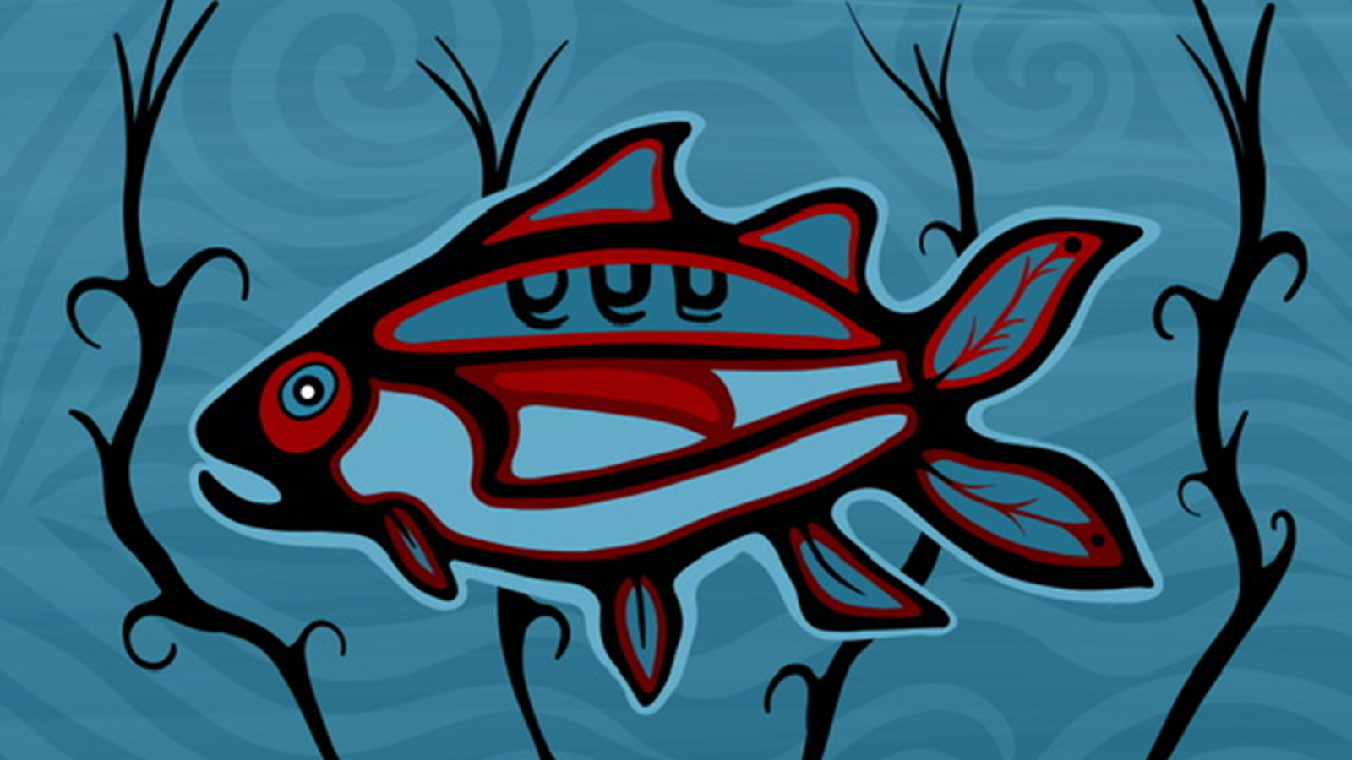

Lessons of the Fish
Chronic Kidney Disease

Slide 2
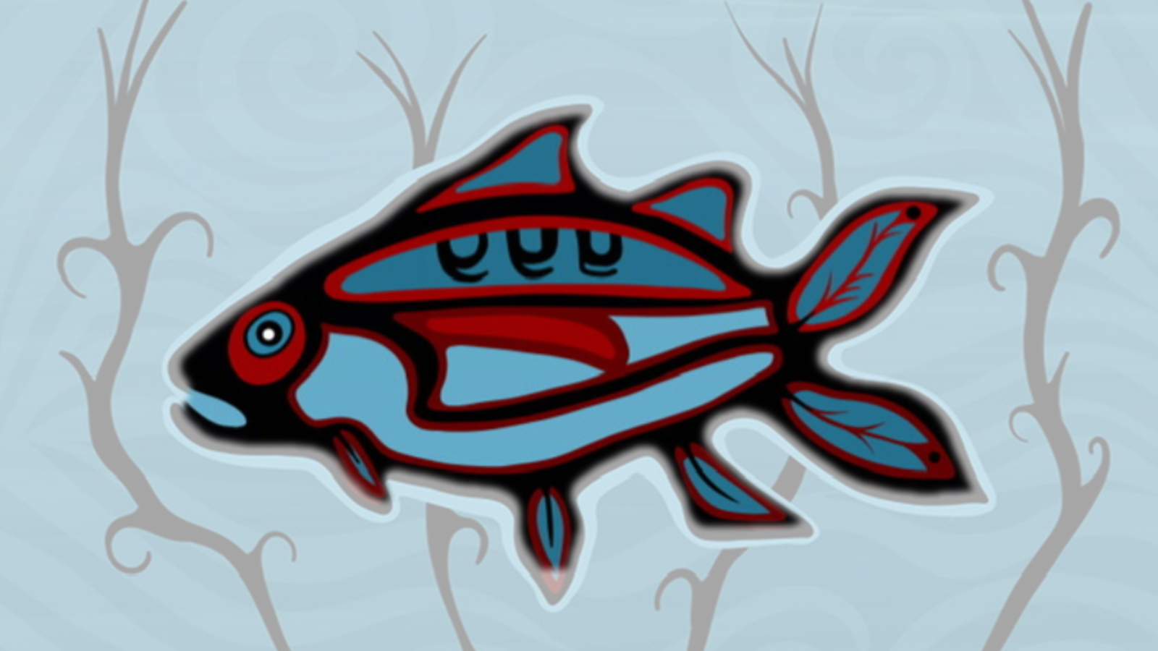
Our direct connection to the well-being of the fish and waters is tied to our very own health and wellness.
We rely on fish for sustenance and medicine.
Our kidneys keep our internal waters clean, and the fish need clean waters to survive and thrive.
The fish teaches us that we have responsibility to both these waters and our own internal waters.

Slide 3
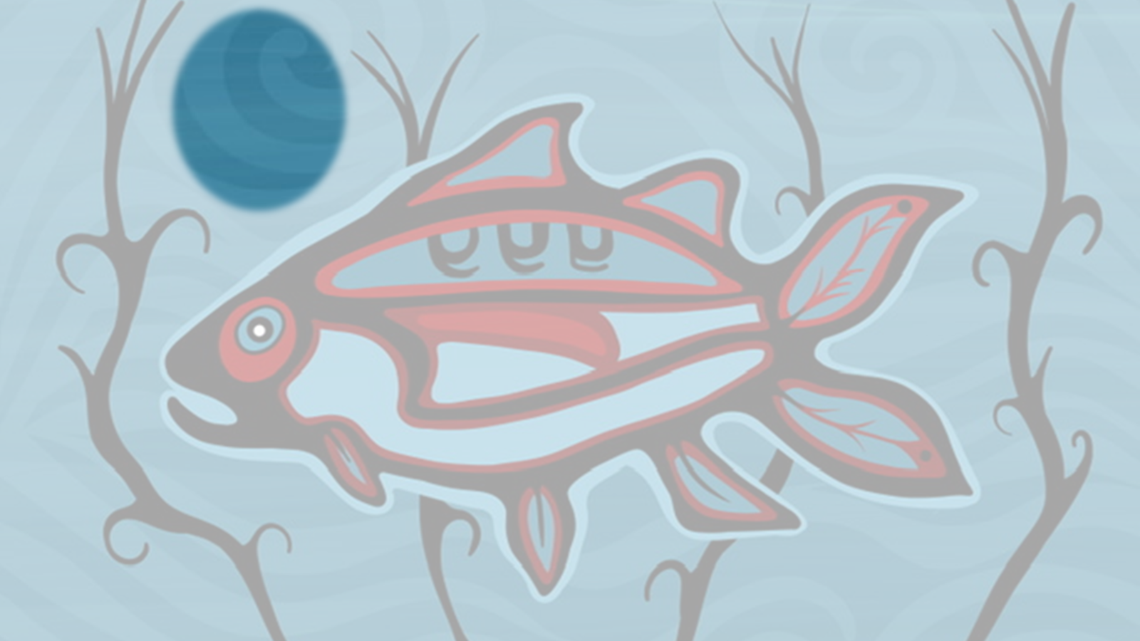
The subtle water movement represents the healthy blood flow in our bodies.
Like the rivers and lakes that need protection, our internal water which is filtered through our kidneys, must be protected.

Slide 4
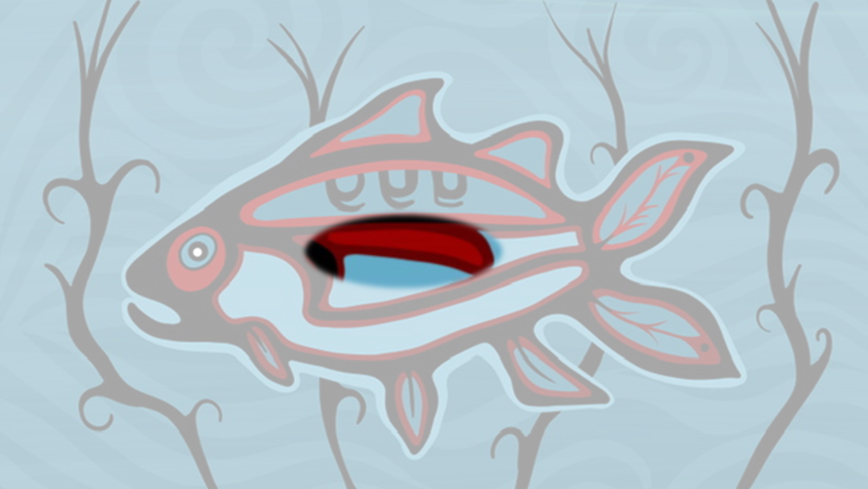
The red color and highlighted kidney represents the importance of healthy blood flow and keeping the kidneys strong to filter the bodies’ blood.

Slide 5
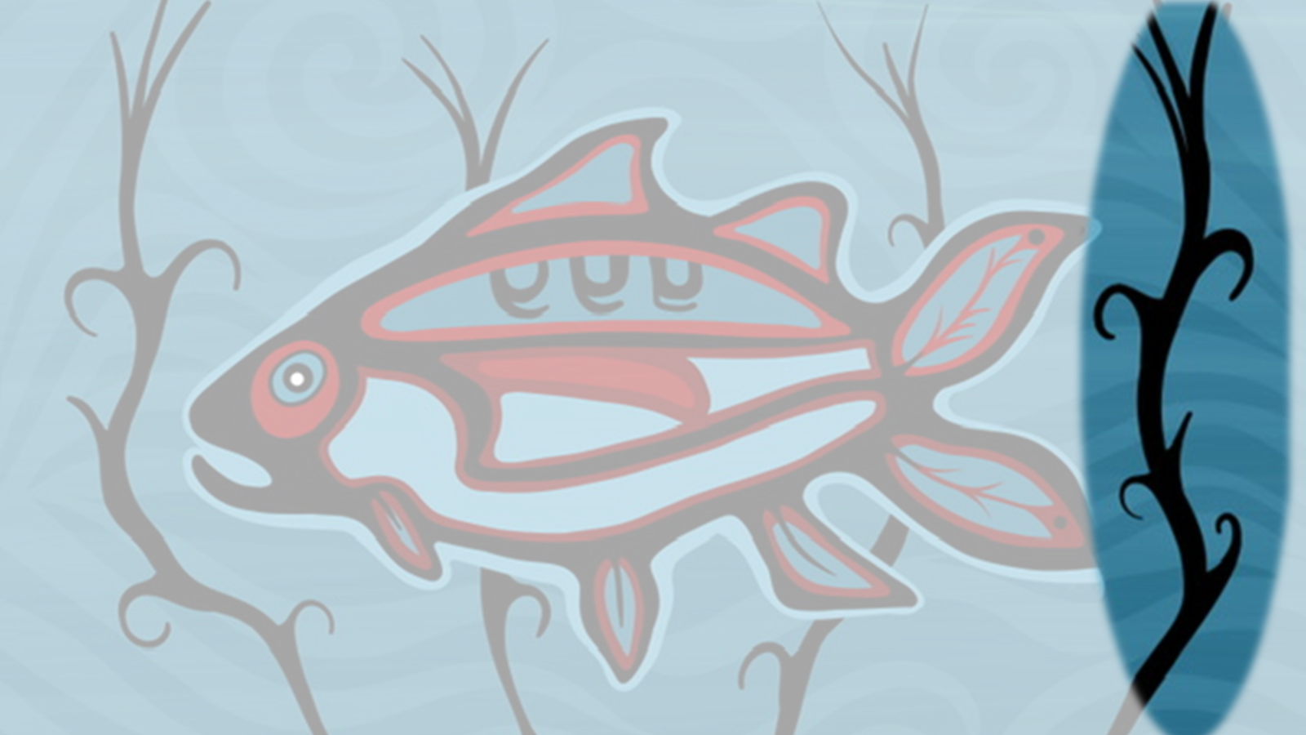
The bold manoomin plants represent the importance of including and honoring the traditional foods that keep us healthy.
The four strands remind us to consider the balance of our mind, body, emotions, and spirit when working on staying well with diabetes management.

Slide 6
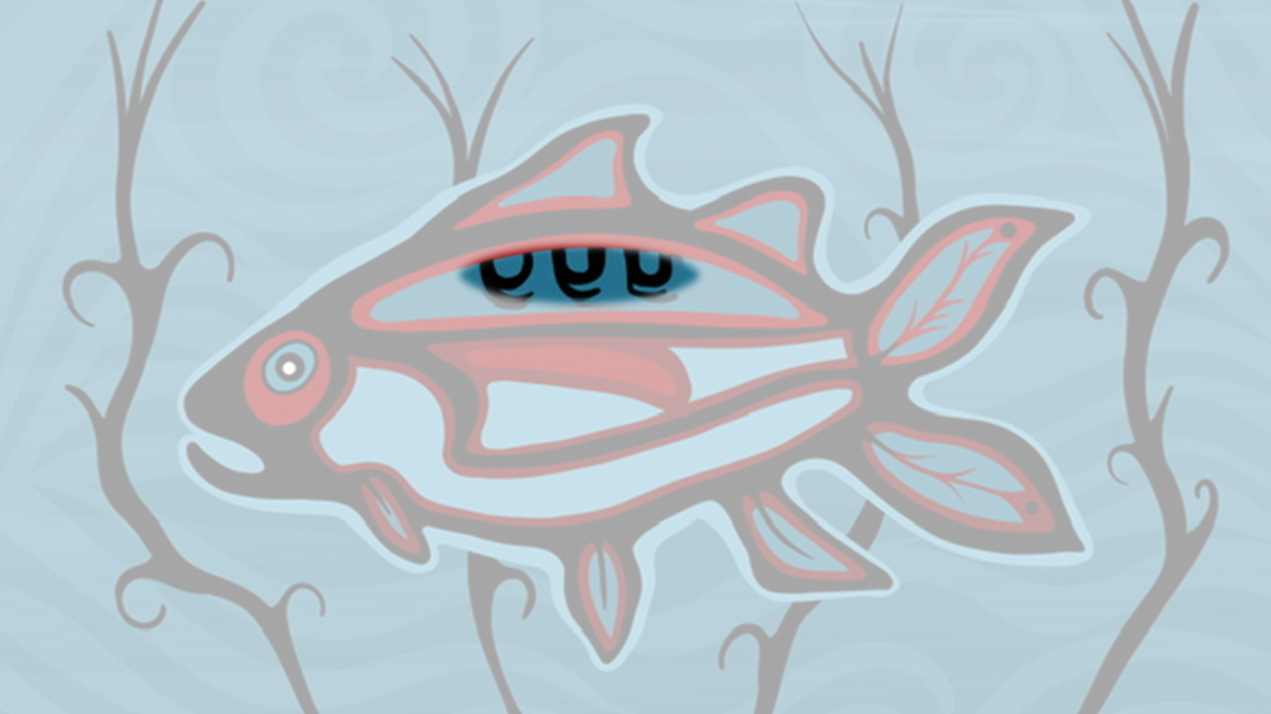
Fish are adaptable and navigate currents.
Healthy strong kidneys help maintain the bodies internal balance.
These three spirals speak to key areas in kidney strength: kidney disease prevention, screening, and early intervention

Slide 7
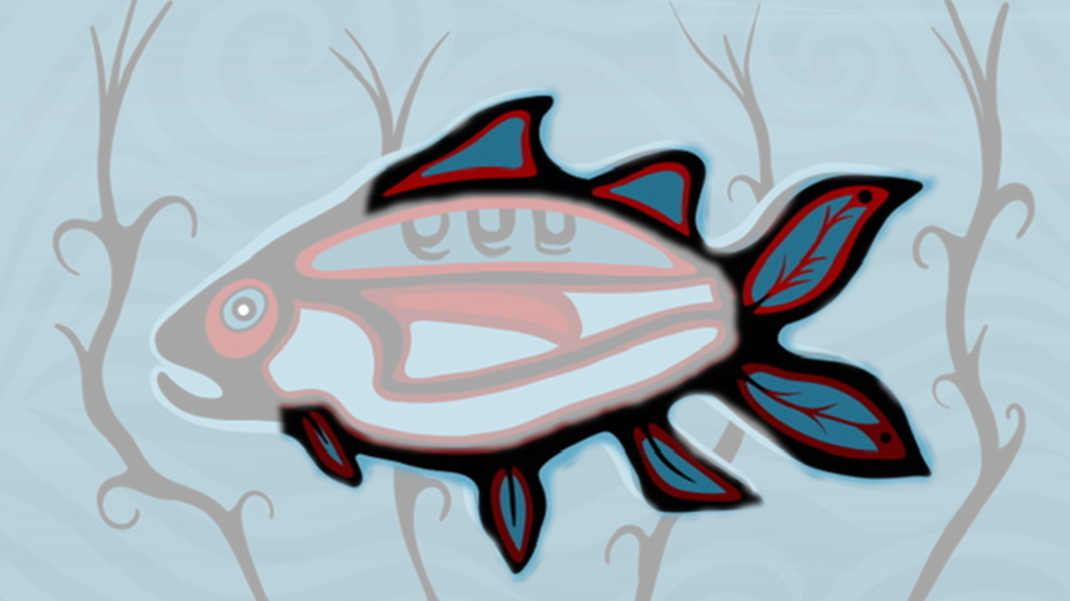
7 Fins of the fish are used to navigate the waters each representing an element of the kidney program:
2. Community partnered mobile and onsite kidney-screening clinics in remote communities
3. Training for community health workers to support ongoing monitoring and prevention work
1. Providing culturally informed health education focused on prevention, early warning signs, nutrition, and land-based wellness practices
7. Providing communities a pathway of healing that restores balance, honors Indigenous cultural healing practices and builds resilience
4. Promotion of wholistic wellness for individuals, families
and communities.
6. Data-informed follow-up pathways to ensure individuals identified at risk receive timely, culturally safe care
5. Knowledge-sharing frameworks that unite traditional healers and western practitioners to design community-specific approaches

Slide 8


